Slide 1
Day 11
Classes and OOPS
Notes:
Did I cover Encapsulation?
Teach Polymorphism if time permist, either here, or at the end of the course.

Slide 2
Class
A class in C++ is the building block, that leads to Object-Oriented programming. It is a user-defined data type, which holds its own data members and member functions, which can be accessed and used by creating an instance of that class. A C++ class is like a blueprint for an object.
For Example: Consider the Class of Cars. There may be many cars with different names and brand but all of them will share some common properties like all of them will have 4 wheels, Speed Limit, Mileage range etc. So here, Car is the class and wheels, speed limits, mileage are their properties.

Slide 3
Class
A Class is a user defined data-type which has data members and member functions.
Data members are the data variables and member functions are the functions used to manipulate these variables and together these data members and member functions defines the properties and behavior of the objects in a Class.
In the above example of class Car, the data member will be speed limit, mileage etc and member functions can be apply brakes, increase speed etc.
An Object is an instance of a Class. When a class is defined, no memory is allocated but when it is instantiated (i.e. an object is created) memory is allocated.

Slide 4
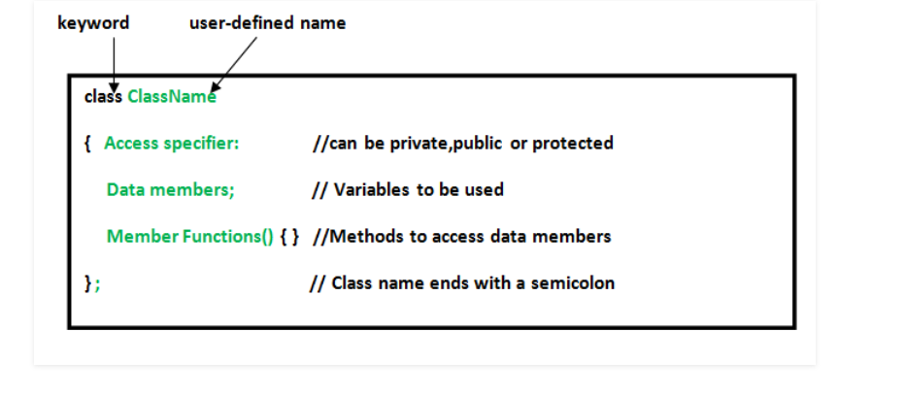
Class
A class is defined in C++ using keyword class followed by the name of class. The body of class is defined inside the curly brackets and terminated by a semicolon at the end.

Slide 5
Declaring Objects
When a class is defined, only the specification for the object is defined; no memory or storage is allocated. To use the data and access functions defined in the class, you need to create objects.
Syntax:
ClassName ObjectName;
The data members and member functions of class can be accessed using the dot(‘.’) operator with the object. For example if the name of object is obj and you want to access the member function with the name printName() then you will have to write obj.printName()

Slide 6
Accessing data members and member functions
The public data members are also accessed in the same way given however the private data members are not allowed to be accessed directly by the object. Accessing a data member depends solely on the access control of that data member.
This access control is given by Access modifiers in C++.

Slide 7
Access Specifiers
In C++, there are three access specifiers:
public - members are accessible from outside the class
private - members cannot be accessed (or viewed) from outside the class
protected - members cannot be accessed from outside the class, however, they can be accessed in inherited classes. You will learn more about Inheritance later.
By default, all members of a class are private if you don't specify an access specifier.

Slide 8
Member Functions in Classes
There are 2 ways to define a member function:
Inside class definition
Outside class definition
To define a member function outside the class definition we have to use the scope resolution :: operator along with class name and function name.

Slide 9
Constructors
Constructors are special class members which are called by the compiler every time an object of that class is instantiated. Constructors have the same name as the class and may be defined inside or outside the class definition.
There are 3 types of constructors:
Default constructors
Parameterized constructors
Copy Constructors
Notes:
Dwell a bit more into Copy Constructor.

Slide 10
Copy Constructor
A Copy Constructor creates a new object, which is exact copy of the existing object. The compiler provides a default Copy Constructor to all the classes.
Syntax:
class-name (class-name &){}

Slide 11
Deconstructor
Destructor is another special member function that is called by the compiler when the scope of the object ends.

Slide 12
Inheritance
The capability of a class to derive properties and characteristics from another class is called Inheritance. Inheritance is one of the most important feature of Object Oriented Programming.
Sub Class: The class that inherits properties from another class is called Sub class or Derived Class.
Super Class:The class whose properties are inherited by sub class is called Base Class or Super class.

Slide 13
Inheritance
Consider a group of vehicles. You need to create classes for Bus, Car and Truck. The methods fuelAmount(), capacity(), applyBrakes() will be same for all of the three classes. If we create these classes avoiding inheritance then we have to write all of these functions in each of the three classes and this increases the chances of error and data redundancy. To avoid this type of situation, inheritance is used. If we create a class Vehicle and write these three functions in it and inherit the rest of the classes from the vehicle class, then we can simply avoid the duplication of data and increase re-usability.

Slide 14
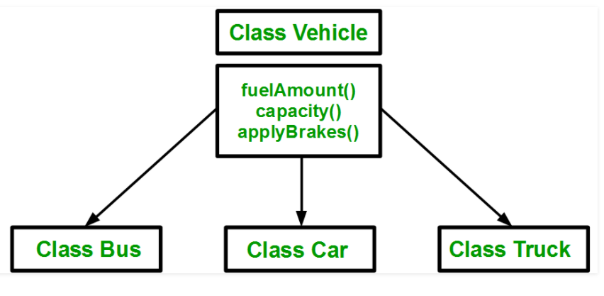
Using inheritance, we have to write the functions only one time instead of three times as we have inherited rest of the three classes from base class(Vehicle).

Slide 15
Implementing Inheritance
For creating a sub-class which is inherited from the base class we have to follow the below syntax.
Syntax:
class subclass_name : access_mode base_class_name
{
//body of subclass
};

Slide 16
Implementing Inheritance
Here, subclass_name is the name of the sub class, access_mode is the mode in which you want to inherit this sub class for example: public, private etc. and base_class_name is the name of the base class from which you want to inherit the sub class.
Note: A derived class doesn’t inherit access to private data members. However, it does inherit a full parent object, which contains any private members which that class declares.

Slide 17
Methods of Inheritance
Public mode: If we derive a sub class from a public base class. Then the public member of the base class will become public in the derived class and protected members of the base class will become protected in derived class.
Protected mode: If we derive a sub class from a Protected base class. Then both public member and protected members of the base class will become protected in derived class.
Private mode: If we derive a sub class from a Private base class. Then both public member and protected members of the base class will become Private in derived class.

Slide 18
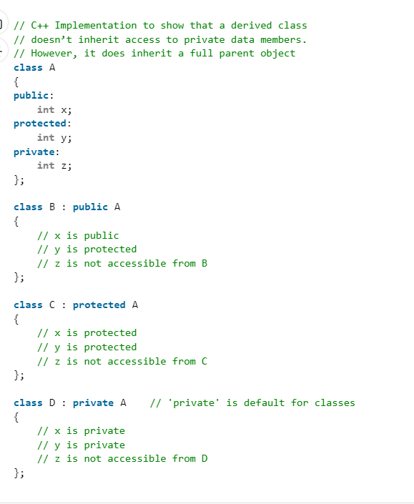
Note : The private members in the base class cannot be directly accessed in the derived class, while protected members can be directly accessed. For example, Classes B, C and D all contain the variables x, y and z in below example. It is just question of access.

Slide 19
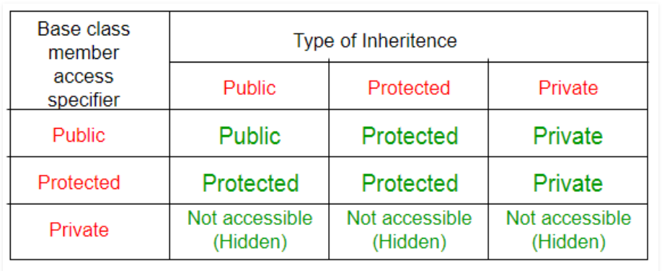

Slide 20
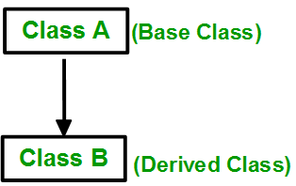
Types of Inheritance
1. Single Inheritance: In single inheritance, a class is allowed to inherit from only one class. i.e. one sub class is inherited by one base class only.
Syntax:
class subclass_name : access_mode base_class
{
//body of subclass
};

Slide 21
Types of Inheritance
2. Multiple Inheritance: Multiple Inheritance is a feature of C++ where a class can inherit from more than one classes. i.e one sub class is inherited from more than one base classes.
Syntax:
class subclass_name : access_mode base_class1, access_mode base_class2, ...
{
//body of subclass
};
Here, the number of base classes will be separated by a comma (‘, ‘) and access mode for every base class must be specified.

Slide 22
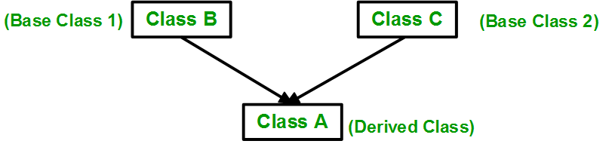
Types of Inheritance

Slide 23
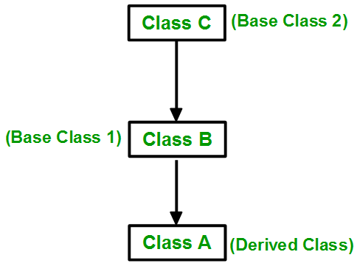
Types of Inheritance
3. Multilevel Inheritance: In this type of inheritance, a derived class is created from another derived class.

Slide 24
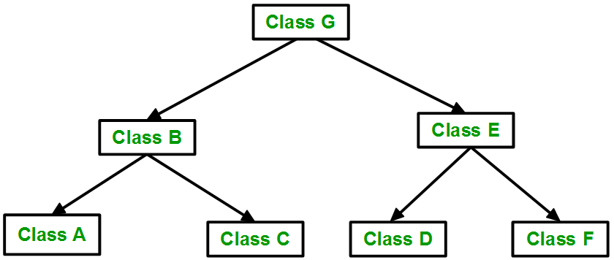
Types of Inheritance
4. Hierarchical Inheritance: In this type of inheritance, more than one sub class is inherited from a single base class. i.e. more than one derived class is created from a single base class.

Slide 25
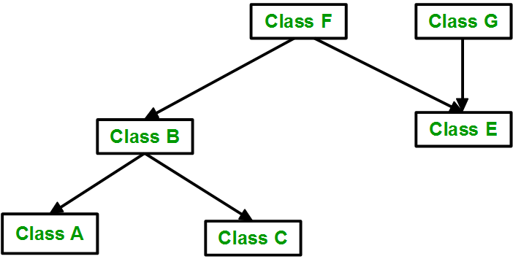
Types of Inheritance
5. Hybrid (Virtual) Inheritance: Hybrid Inheritance is implemented by combining more than one type of inheritance. For example: Combining Hierarchical inheritance and Multiple Inheritance.

